Slide 1
1459i
Hesenova Firuze
OS-2 course work
Developing device drivers in assembly language

Slide 2
What are Device Drivers?
In computing a device driver refers to a computer program, which controls or operates a particular type of device that is attached to the computer. A device driver provides a software interface to hardware devices, thus enabling operating systems and computer programs to access and communicate with the hardware functions without requiring to acknowledge prices details about the hardware that is being used.
Many computer components require device drivers, and some common examples are:
Graphic cards, computer printers, scanners, modems, sound cards, network cards etc.

Slide 3
Likewise, there are other computer peripherals, which don’t require device drivers, as driver is already built in the operating system, therefore when those peripherals are required, the operating system recognises them and knows how to use them.
Examples of such parts include:
USB sound cards, USB hubs (a component which turns one USB to two or more), hard drives, floppy drives, mouse, keyboard, RAM’s, processors, CD, DVD etc.

Slide 4
How do Device Drivers Work?
Device drivers function by relaying requests for device access and actions from the operating system and any active application to the respective hardware devices. Furthermore, device drivers also deliver outputs or messages/status from the hardware devices to the operating system (and thus to the applications themselves).
Device drivers operate within the kernel of the operating system. The kernel is a part of the of the operating system that has direct interactions with the physical structure of system.
Rather than interacting and accessing the new device directly, the operating system will load the device drivers and it will call the specific functions within the driver software to execute specific tasks on the device, for instance in our case, printing a sheet of paper or scanning a document, thus meaning that each driver has the device specific content codes which are required to carry out the actions on the device.

Slide 5
Purpose of Device Drivers:
Operate and control a device attached to a computer
Provide an interface between the operating system (or application) and the device
To tell the operating system how to communicate with the hardware component
Translate requests between the device and the computer

Slide 6
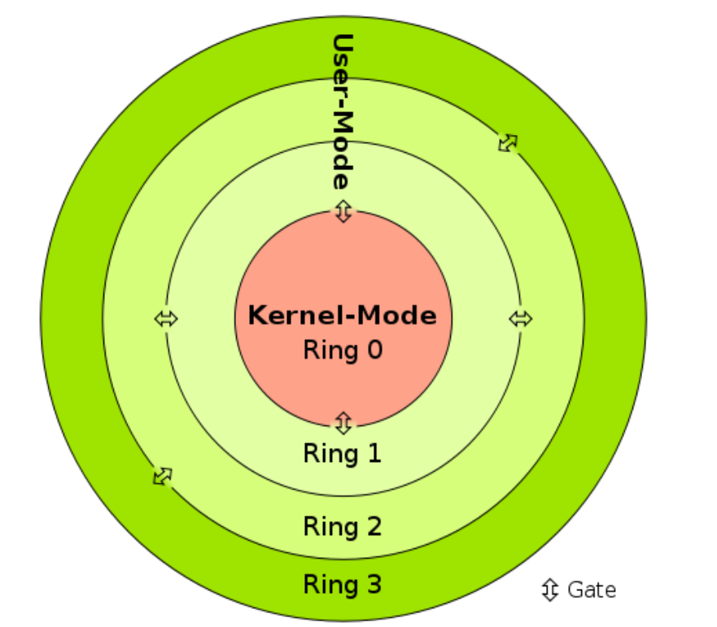
Types of Device Drivers
Device drivers can be broadly classified into two categories:
Kernel Device Drivers
User Mode Device Drivers

Slide 7
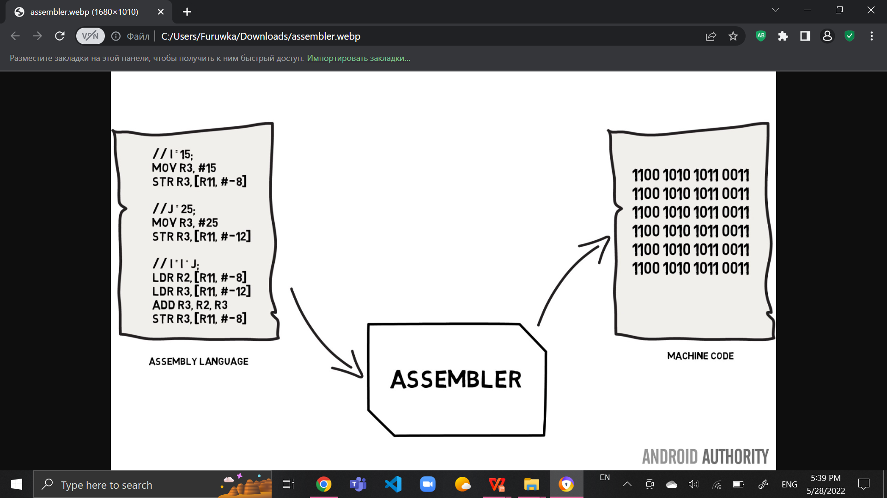
Assembly language
An assembly language is a type of programming language that translates high-level languages into machine language.
It is a necessary bridge between software programs and their underlying hardware platforms.
Today, assemble languages are rarely written directly, although they are still used in some niche applications such as when performance requirements are particularly high.

Slide 8
Why is learning assembly language still important?
Despite the prevalence of high-level languages that are mainly used for the development of applications and software programs, the importance of assembly language in today’s world cannot be understated. A programmer can still gain a lot if he/she can learn to code in assembly language and implement it. These days, assembly language makes it possible to manipulate hardware directly, address critical issues concerning performance and also provide access to special instructions for processors. Uses of assembly language include coding device drivers, real-time systems, low-level embedded systems, boot codes, reverse engineering and more.

Slide 9
Assembly code
.data
msgCaption db"Message box text",0
.code
ALIGN 16
EXTERN GetMsgBoxType : PROC;
EXTERN MessageBoxA : PROC
EXTERN __imp_MessageBoxA : QWORD
asm_func PROC
; RCX = address for the string for the message box
sub rsp, 28h ; shadow stack
mov [rsp], rcx
call GetMsgBoxType
mov r9, rax
mov r8, [rsp]
lea rdx, [msgCaption]
xor ecx, ecx
call [__imp_MessageBoxA]
add rsp, 28h ; restoring shadow stack
ret
asm_func ENDP
END

Slide 10
C++ code to call our Assembly function
#include <iostream>
#include <Windows.h>
extern "C" void __fastcall asm_func(const char* lpText);
int main()
{
asm_func("Hello world!");
}
extern "C" UINT GetMsgBoxType()
{
return MB_YESNOCANCEL | MB_ICONINFORMATION;}

